Slide 1
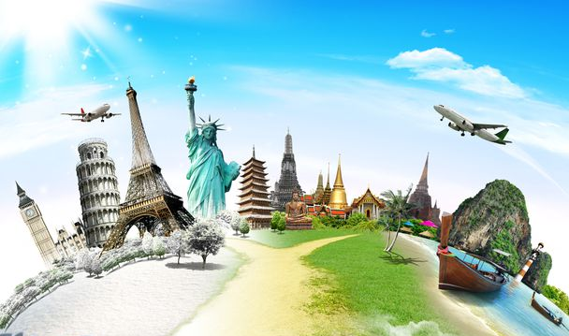

Doing Business Globally
BMX305 Doing Business Globally
Country External Factors –
POLITICAL
/ LEGAL FORCES
DIFFERENCES AMONG COUNTRIES

Slide 2

Lecture topics: 1. Political systems 2. Political forces 3. Legal forces
Covered over 2 lectures – Week 3 and Week 4

Slide 3

1. Political systems

Slide 4


Political system &
the Government
of a country shapes:
Env & Legal
Political
Social-cultural
Technological
Economical

Slide 5

Political system – the system of government in a nation
Two dimensions:
Collectivism Individualism
Democracy Totalitarianism
1.
2.

Slide 6


Political system – the system of government in a nation
Two dimensions:
Collectivism Individualism
Democracy Totalitarianism
1.
2.

Slide 7
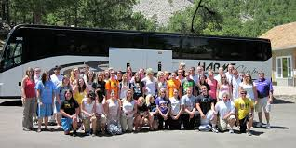
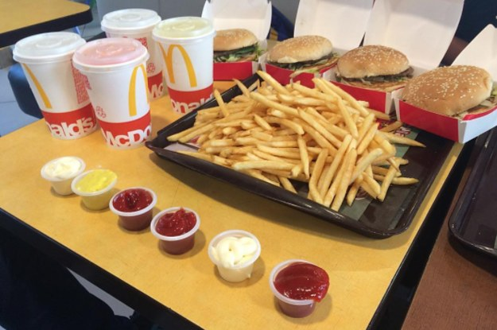

Political system – the system of government in a nation
Two dimensions:
Collectivism Individualism
Democracy Totalitarianism
1.
the collective well-being of the group
2.

Slide 8

Political system – the system of government in a nation
Two dimensions:
Collectivism Individualism
Democracy Totalitarianism
1.
the collective well-being of the group
2.

Slide 9
Political system – the system of government in a nation
Two dimensions:
Collectivism Individualism
Democracy Totalitarianism
1.
Countries that are more collective?
the collective well-being of the group
2.

Slide 10
Political system – the system of government in a nation
Two dimensions:
Collectivism Individualism
Democracy Totalitarianism
1.
value individual liberty and freedom and see it as the key to human flourishing
2.

Slide 11


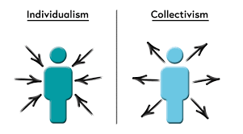
Political system – the system of government in a nation
Two dimensions:
Collectivism Individualism
Democracy Totalitarianism
1.
value individual liberty and freedom and see it as the key to human flourishing
2.

Slide 12

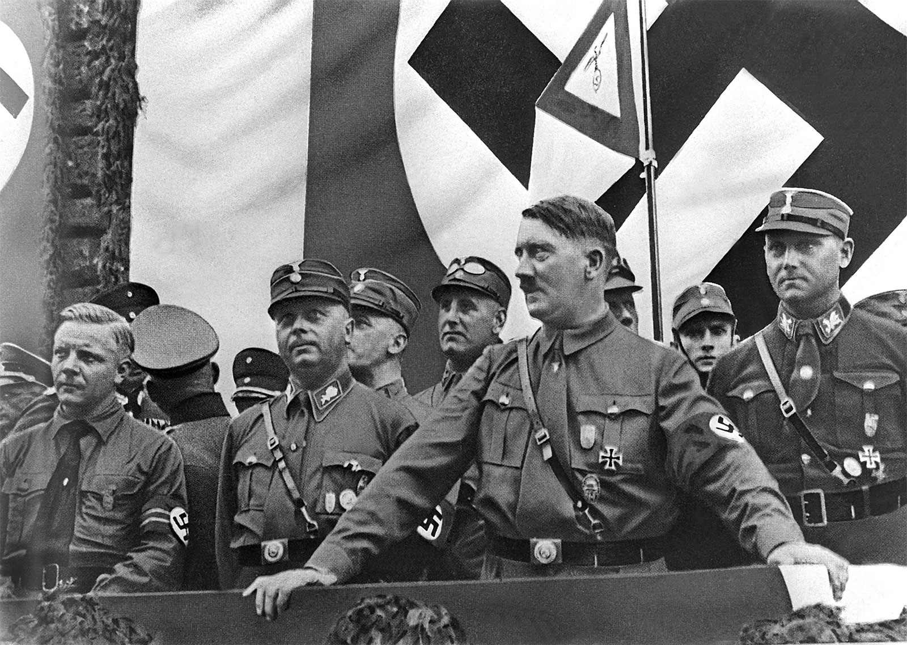
Political system – the system of government in a nation
Two dimensions:
Collectivism Individualism
Democracy Totalitarianism
1.
2.

Slide 13
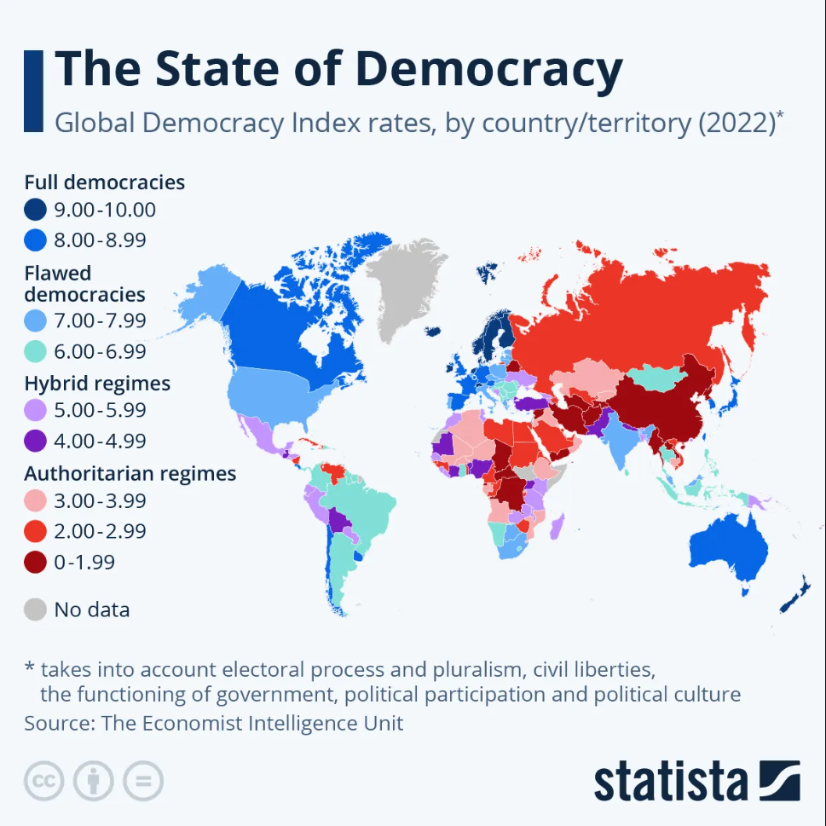
Available on NYP Library Portal
Notes:
Chart: The State of Democracy | Statista (remotexs.co)

Slide 14
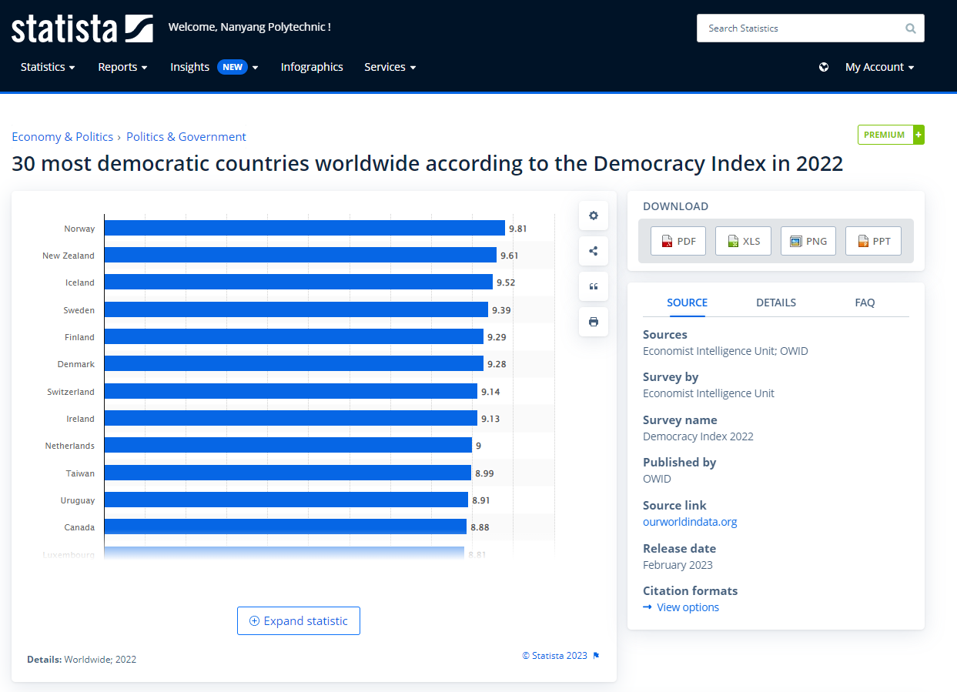
Available on NYP Library Portal

Slide 15
2. Political forces

Slide 16
ICA 1 - What to do?
ICA 1 (40%)
(1) identify a real-world event/issue that has an impact on Singapore. The event/issue must be within the recent six (6) months and is still evolving, and
(2) elaborate on how the event/issue might have an impact on Singapore by considering the Political (PESTLE) factor.
Write less than 200 words

Slide 17
Political forces that affect global trade
Governments & ownership of business
Government stability & protection
Government intervention in trade

Slide 18


1. Governments & ownership of business
Privatisation – the selling of government owned property to the private sector
Nationalisation – the taking of private property by a government to make it public (owned by government)
Usually involves companies in fuel, public transportation, airline, media (newspaper) etc.
Could be positive or negative …

Slide 19
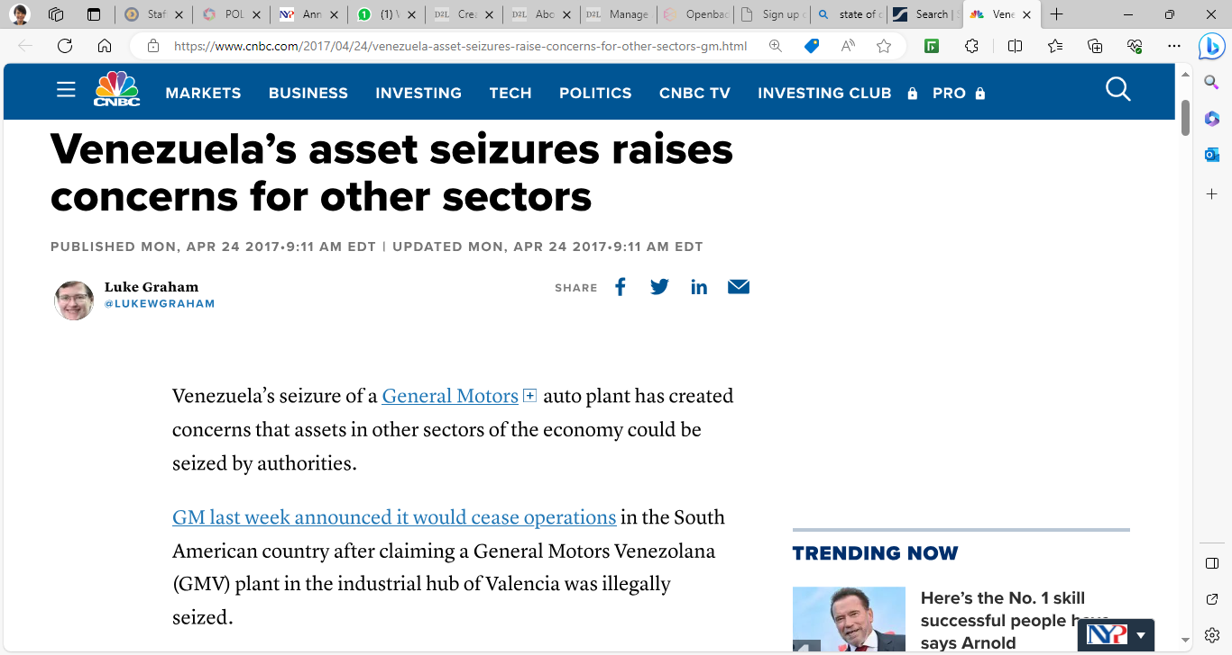
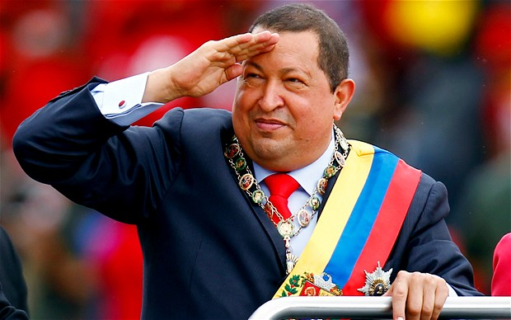
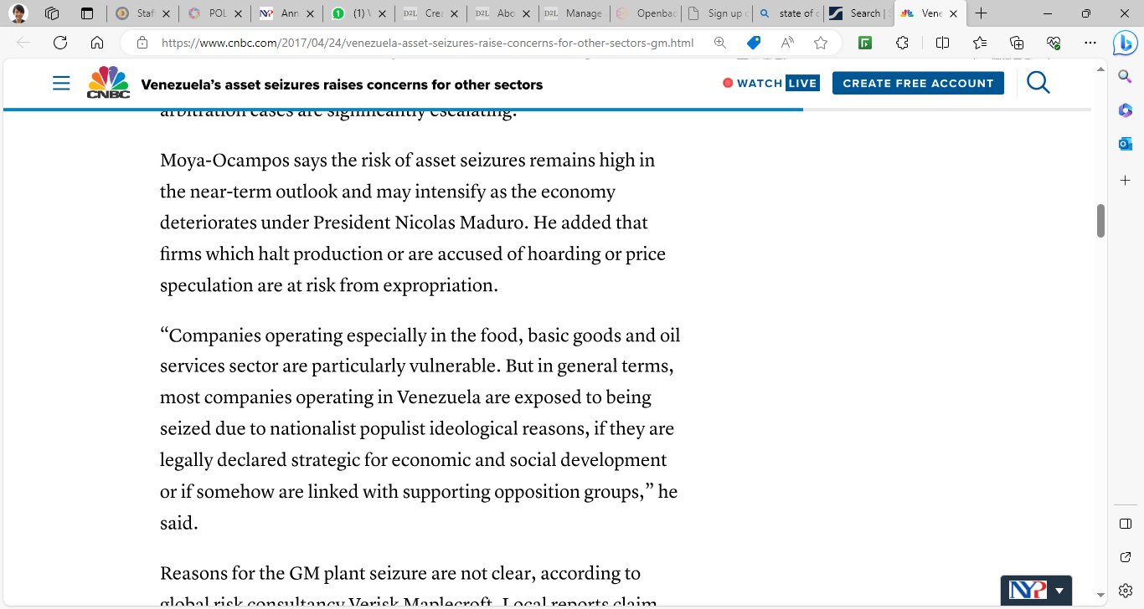
Example of Hostile seizure of foreign companies’ assets
Hugo Chavez 1999-2013
Venezuela’s asset seizures raises concerns for other sectors (cnbc.com)
Other examples … in Somalia, Syria, North Korea

Slide 20
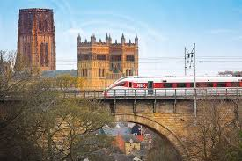
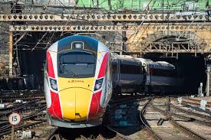
Examples of positive nationalization:
One example of how nationalisation can benefit the public interest is England’s East Coast Main Line, a rail route running from London to Edinburgh. In 1997, the line was privatised, but in 2009 operator National Express East Coast was stripped of the franchise after getting into financial difficulties.
The line was then returned to state control for the next six years (2009-2015), during which period customer satisfaction rose significantly. The government-owned line also turned a healthy profit, returning around £200m a year to the Treasury.
https://www.theweek.co.uk/101318/the-pros-and-cons-of-nationalisation#:~:text=One%20example%20of%20how%20nationalisation,after%20getting%20into%20financial%20difficulties.

Slide 21
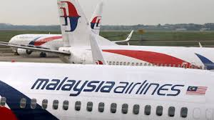
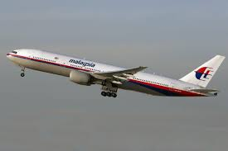
Examples of positive nationalization:
Malaysia’s state investment fund has unveiled plans to make Malaysia Airlines fully government owned, as it prepares to carry out a far-reaching overhaul of the carrier that is reeling from double disasters.
In August 2014, majority shareholder, Khazanah Nasional, said it would purchase all minority shares and finalise a restructuring plan by the end of the month.
https://www.aljazeera.com/economy/2014/08/08/malaysia-airlines-to-be-nationalised/#:~:text=Malaysia's%20state%20investment%20fund%20has,is%20reeling%20from%20double%20disasters.

Slide 22
Political forces that affect global trade
Governments & ownership of business
Government stability & protection
Government intervention in trade

Slide 23
Government
stability & protection
Stable government with policies that are permanent or that change only gradually
Social stability (threats like strikes, protests, robbery, kidnapping) – protection & safety for assets and people
Protection from other threats e.g. terrorism, cybercrime

Slide 24
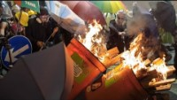
Hong Kong protests: General strike paralyzes city as clashes with police intensify
demonstrators continued to demand Carrie Lam (HK Chief Executive) resignation and to withdraw a controversial extradition bill.
Stop 1:22

Slide 25
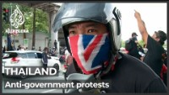
Thailand – against government ways of handling pandemic

Slide 26
Political forces that affect global trade
Governments & ownership of business
Government stability & protection
Government intervention in trade

Slide 27
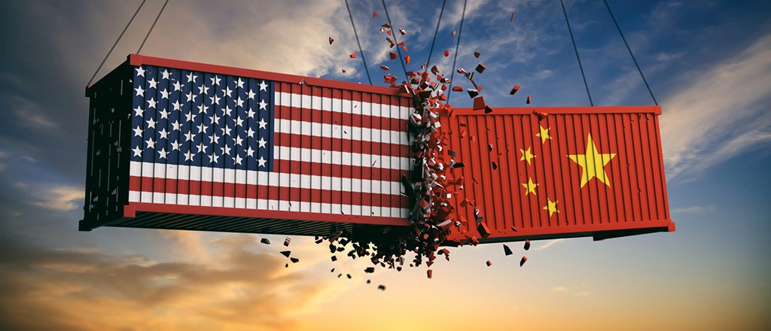
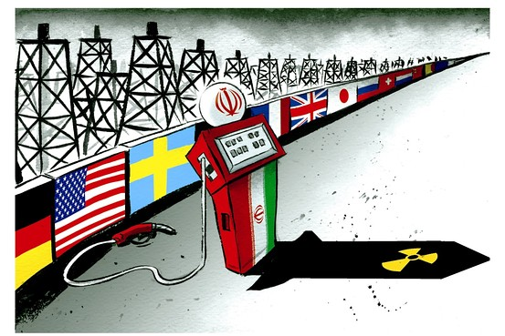
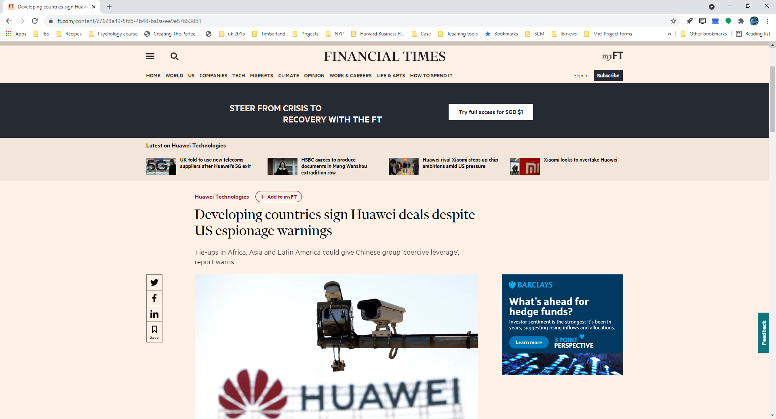
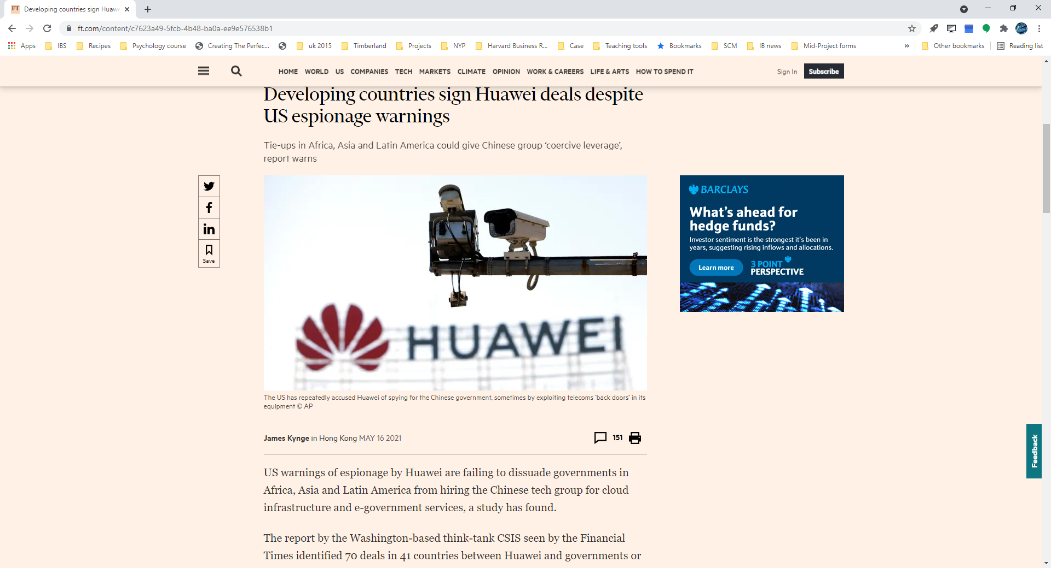
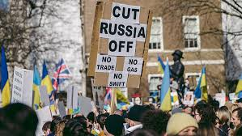
Government intervention in trade
Government’s reasons:
Provide for national defence
Impose sanctions – to punish other nations
Protect an infant or dying local industry
Protect domestic jobs
Ensure fair competition
Retaliate

Slide 28
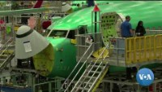
US-China Trade War: Tariffs Explained
Stop 1:40

Slide 29
Government intervention in trade
Impact on business:
Tariffs – increase costs (for foreign businesses)
Subsidies to local businesses (help them by reducing their costs)
Customs & other administrative procedures – costly processes (for foreign businesses)
Additional standard requirements – higher costs (for foreign businesses

Slide 30
3. Legal forces

Slide 31
Legal forces that affect global trade
Health of the legal systems
International legal forces
Intellectual property rights
Competition Laws / Antitrust Laws

Slide 32
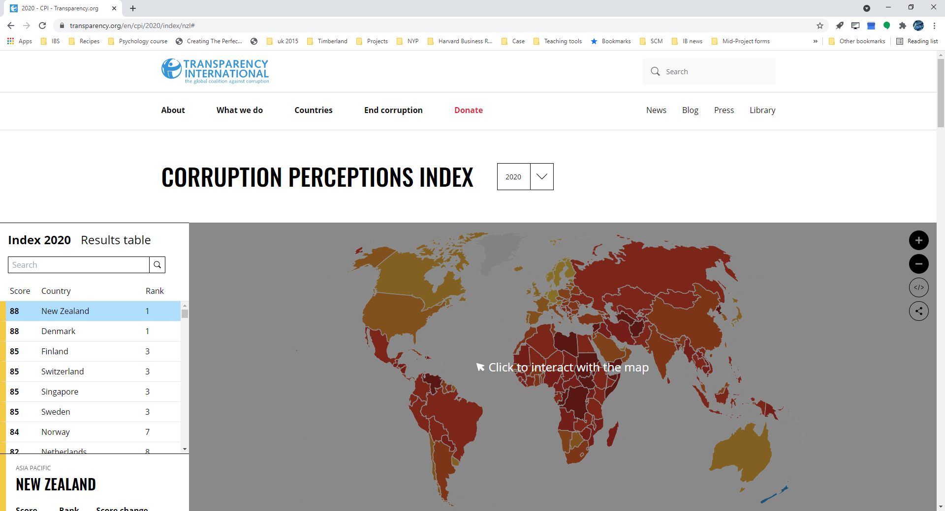
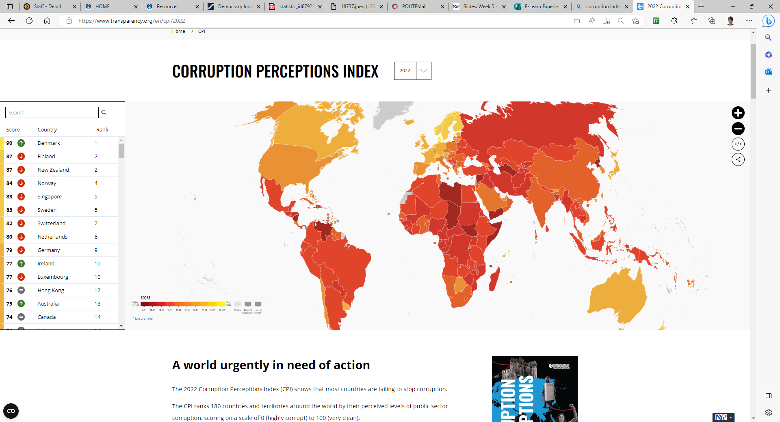

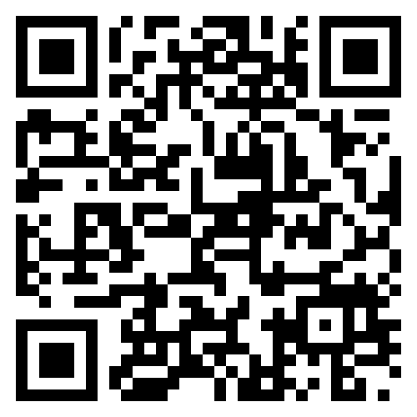
Legal systems
Level of bureaucracy
Strength of the courts of justice
Level of corruption
Singapore - the least corrupted country in Asia
Corruption Perceptions Index (CPI)

Slide 34
Legal forces that affect global trade
Legal systems
International legal forces
Intellectual property rights
Competition Laws / Antitrust Laws

Slide 35
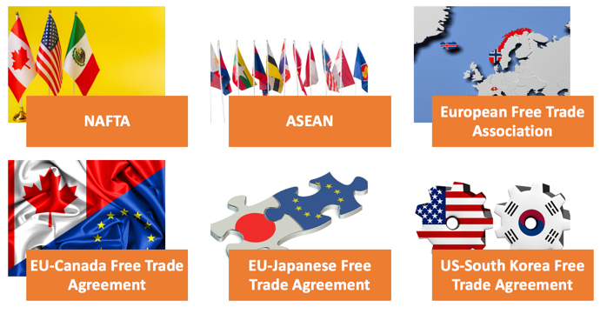
International legal forces
Protection of investors’ interests or human rights of local people
International law – agreement between countries

Slide 36
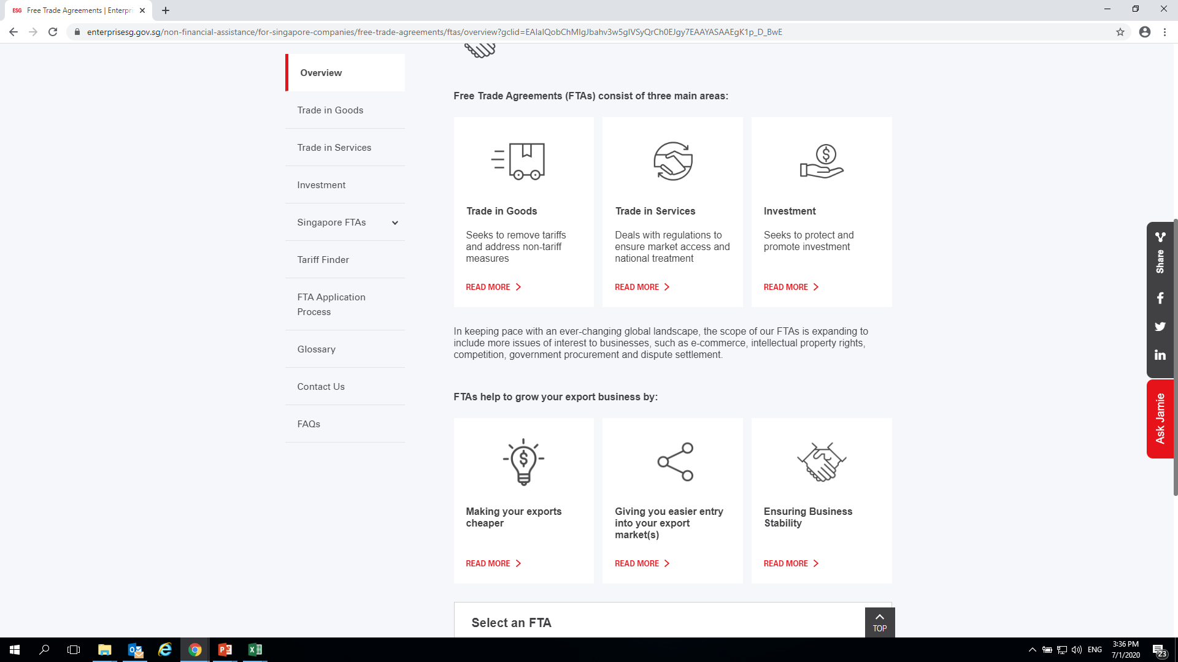
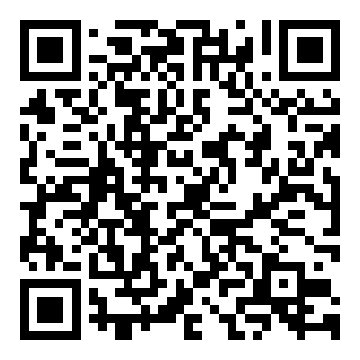

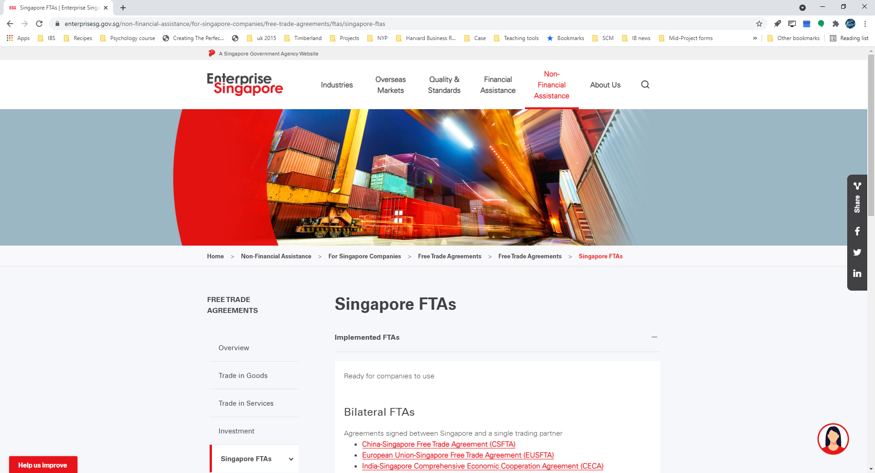
International legal forces
Singapore is part of 27 FTAs
(Free Trade Agreements - regional and bilateral)
As of 8 April 2022

Slide 37
Legal forces that affect global trade
Legal systems
International legal forces
Intellectual property rights
Competition Laws / Antitrust Laws

Slide 38

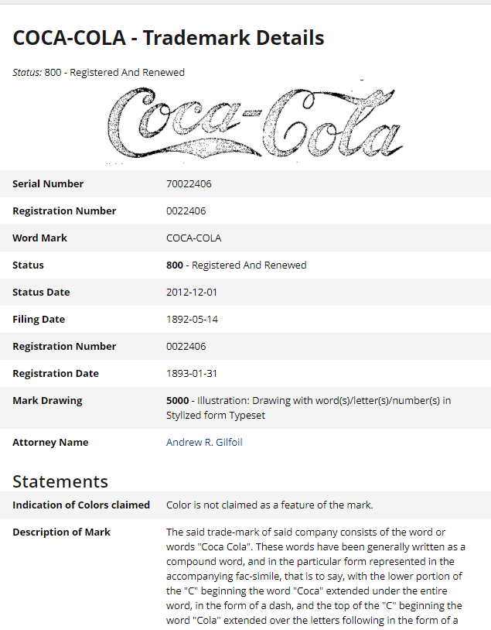
Intellectual property rights
Patents
World Intellectual Property Organisation (WIPO) – UN
Trade-Related Aspects of Intellectual Property Rights (TRIPS) – WTO
Trademarks
Trade names
Copyrights
Trade secrets

Slide 39
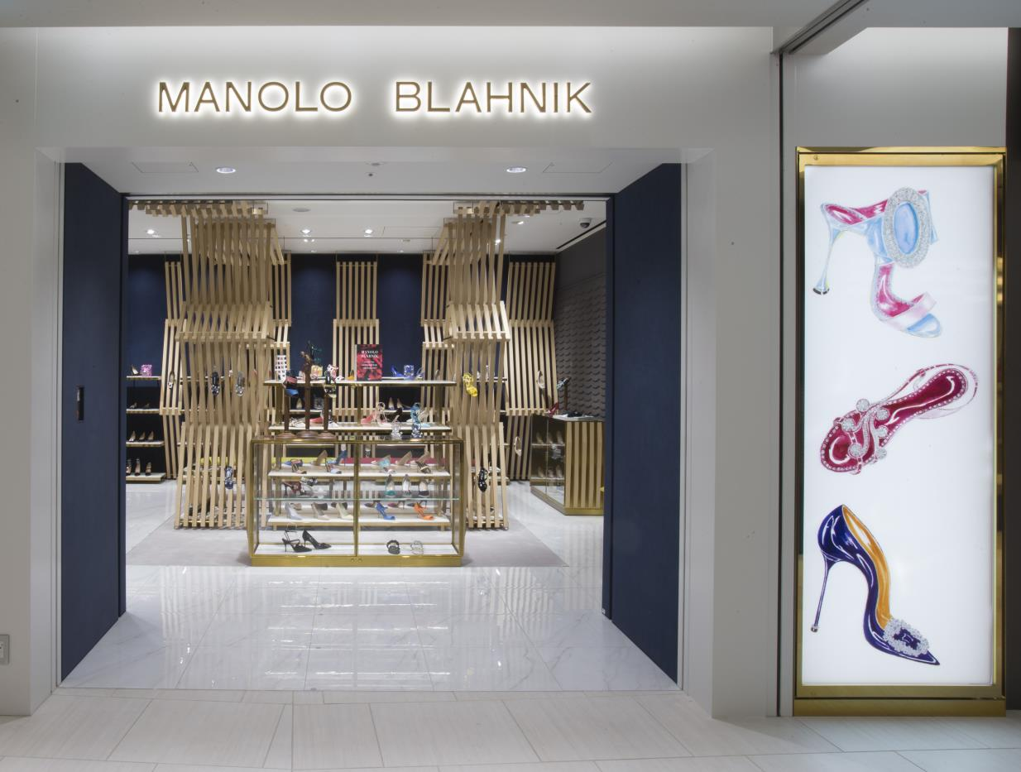
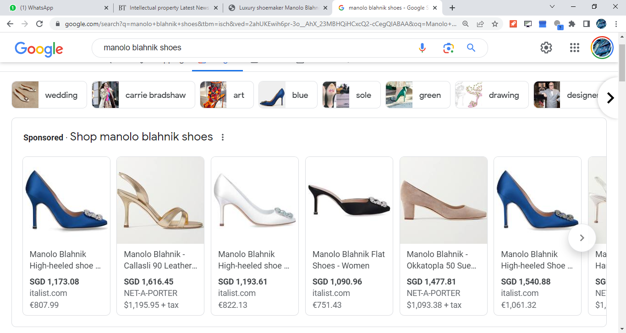

Slide 40
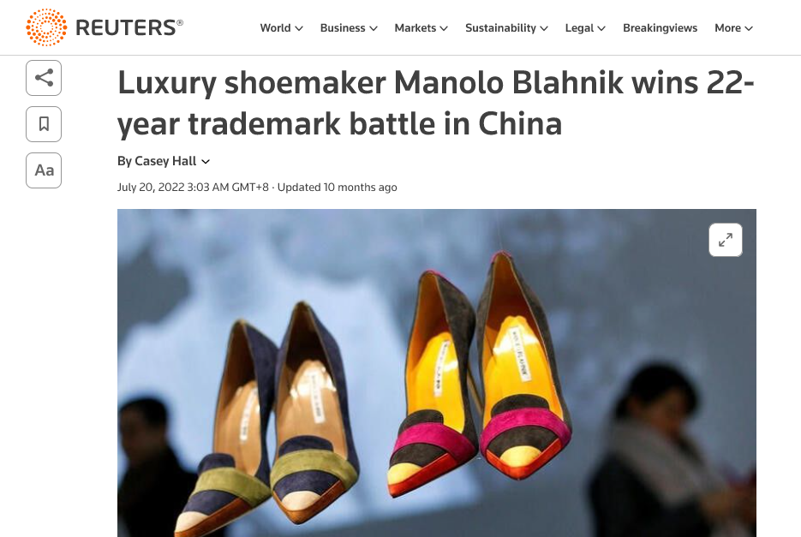

Slide 41
Legal forces that affect global trade
Legal systems
International legal forces
Intellectual property rights
Competition Laws / Antitrust Laws

Slide 42
Competition Laws / Antitrust Laws
Intended to prevent inappropriately large concentrations of economic power, such as monopolies
Government against business or business against another

Slide 43

Tencent's boss vows "compliance" with China regulators on anti-monopoly laws
Stop at 1:17

Slide 44
Is the country’s political and legal forces favourable to your business?

Slide 45
Political factors:
Governments & ownership of business
Government stability & protection
Government intervention in trade
ICA 1 (40%)
(1) identify a real-world event/issue that has an impact on Singapore. The event/issue must be within the recent six (6) months and is still evolving, and
(2) elaborate on how the event/issue might have an impact on Singapore by considering the Political (PESTLE) factor.
Write less than 200 words

